Slide 1
Deepfake Detection
CMPE593: Deep Learning for Computer Vision
Final Project Presentation
Emirhan Bilgiç
May, 2024

Slide 2
Problem Definition
Deepfake pictures are hyper-realistic digital manipulations of audiovisual content that can convincingly mimic real people saying or doing things they never did.
It poses significant challenges in the realms of misinformation, privacy, and security.
Pan, Z., Ren, Y., & Zhang, X. (2021). Low-complexity fake face detection based on forensic similarity. Multimedia Systems, 27, 1–9.

Slide 3
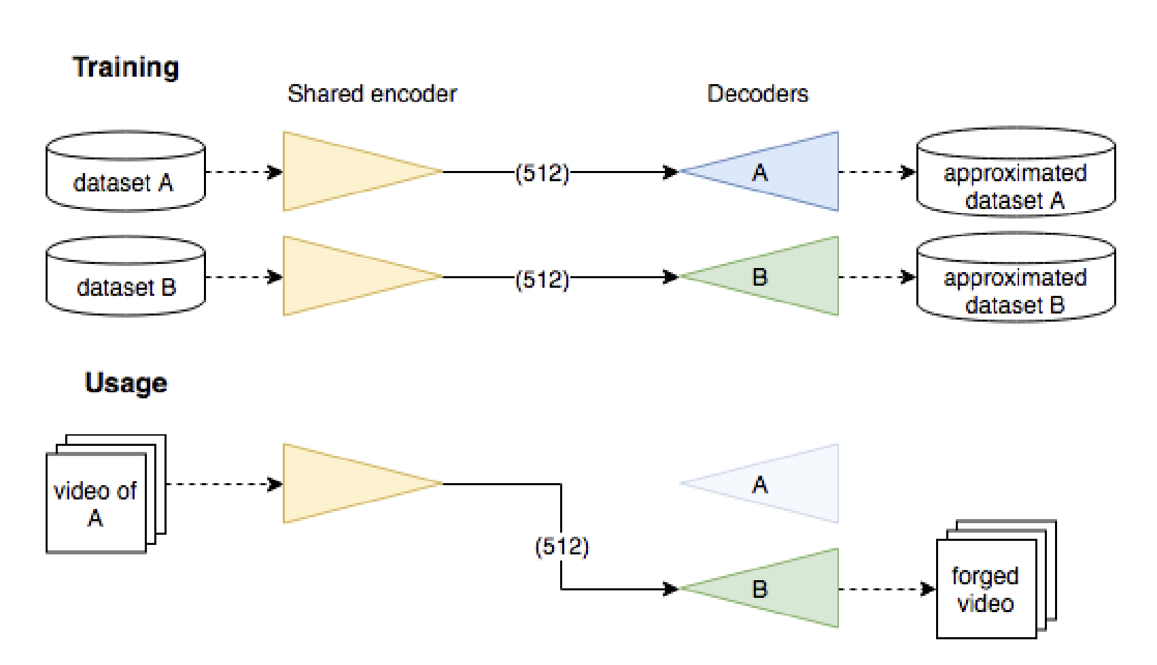
How to Generate Deepfakes?
Creating deepfakes involves advanced deep learning techniques to swap faces in videos. Faces of A are detected and extracted frame-by-frame from the original video and fed into the shared encoder. This encoding captures features like expressions and lighting. Instead of using A's decoder, B's decoder is used to recreate the faces, resulting in B's face with A's features.
There are different methods for face manipulation such as face2face and faceswap, but the general name for face manipulation is deepfake.
Afchar, D., Nozick, V., Yamagishi, J., & Echizen, I. (2018, December). Mesonet: a compact facial video forgery detection network. In 2018 IEEE international workshop on information forensics and security (WIFS) (pp. 1-7). IEEE.

Slide 4
Datasets
The datasets used in the creation, detection, training, and testing phases of deepfakes include:
Dataset | Release Date | Real/Fake | Source
FaceForensics++ (Face2Face) | 2019.0 | 1000/4000 | YouTube
DFDC | 2019.10 | 23,654/104,500 | Actors
Celeb-DF | 2019.11 | 890/5639 | YouTube
DeeperForensics | 2020.1 | 10,000/50,000 | Actors
Yu, P., Xia, Z., Fei, J., & Lu, Y. (2021). A survey on deepfake video detection. Iet Biometrics, 10(6), 607-624.

Slide 5
Datasets
Except for the first deepfake detection methods like MesoNet and MesoInception, what is difficult in a deepfake detection challenge, and what is noted in the papers, is usually always similar:
It is not about building a good model using as much data as possible, but about using only FF++ dataset to get the best performance on various datasets.

Slide 6
Methods
1- MesoNet
2- MesoInception
3- Xception
4- Face X-Ray (CVPR 2020)
5- On Improving Cross-dataset Generalization of Deepfake Detectors (CVPR 2022)
6- Implicit Identity Leakage (CVPR 2023)
7- Emirhan’s Method: BLIP
Bonus: Evading DeepFake Detectors via Adversarial Statistical Consistency (CVPR 2023)

Slide 7
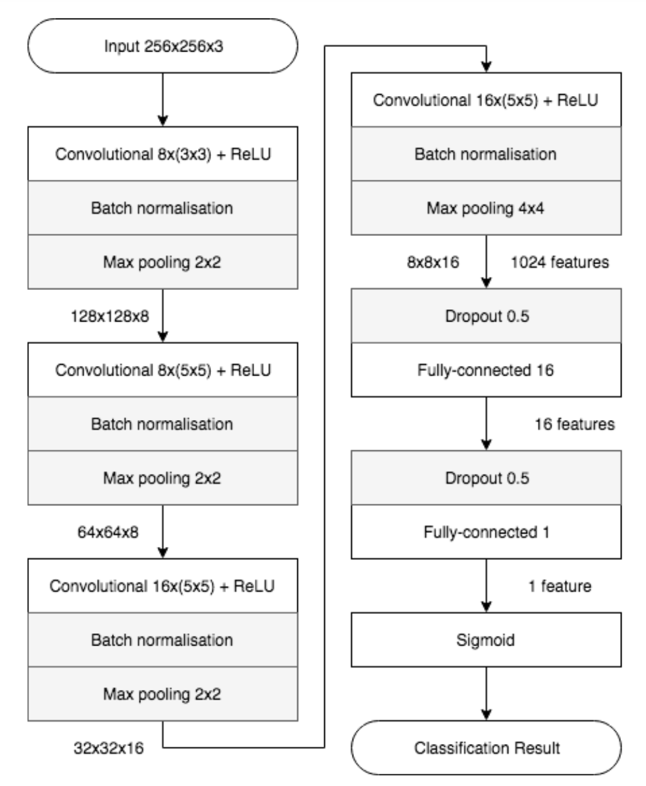
MesoNet
The MesoNet is a CNN architecture designed for deepfake facial manipulation detection by focusing on capturing “mesoscopic” features within images.
Afchar, D., Nozick, V., Yamagishi, J., & Echizen, I. (2018, December). Mesonet: a compact facial video forgery detection network. In 2018 IEEE international workshop on information forensics and security (WIFS) (pp. 1-7). IEEE.

Slide 8
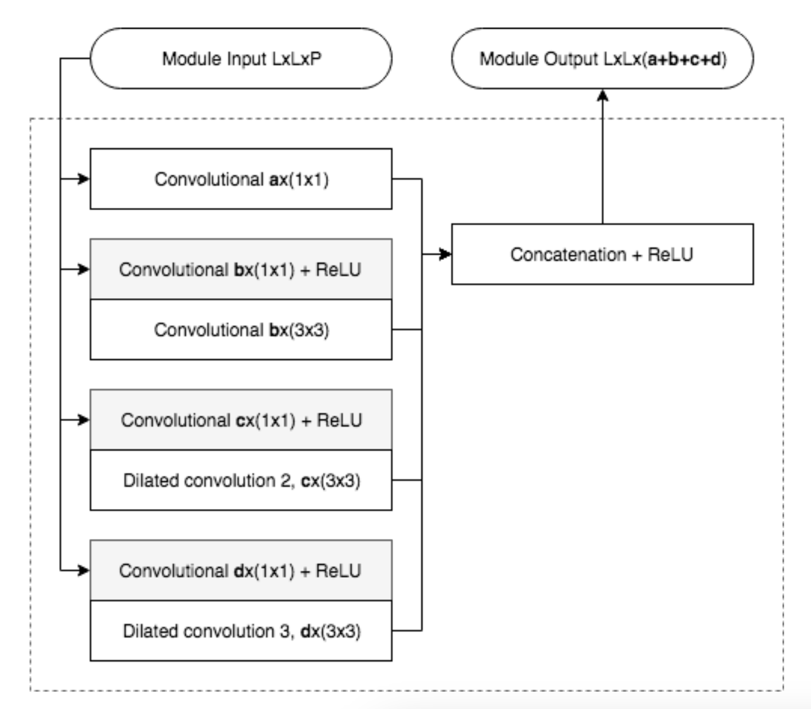
MesoInception
MesoInception enhances the Meso-4 architecture by integrating inception modules, which enable the network to capture multi-scale features through parallel convolutions with various kernel sizes.
Afchar, D., Nozick, V., Yamagishi, J., & Echizen, I. (2018, December). Mesonet: a compact facial video forgery detection network. In 2018 IEEE international workshop on information forensics and security (WIFS) (pp. 1-7). IEEE.

Slide 9
Results of MesoNet and MesoInception
The Deepfake dataset created by the authors and Face2Face from FaceForensics dataset were used to train the models.
Set | Deepfake Class | Real Class
Deepfake training Deepfake testing | 5111 2889 | 7250 4259
Face2Face training Face2Face testing | 4500 3000 | 4500 3000
Network | Face2Face Classification Score (AUC)
Compression Level | 0 | 23 (light) | 40 (strong)
MesoNet MesoInception | 0.946 0.968 | 0.924 0.934 | 0.832 0.813
In contrast to these results, the focus of the following papers is to compare cross-dataset performances using only FF++ data for training.
Afchar, D., Nozick, V., Yamagishi, J., & Echizen, I. (2018, December). Mesonet: a compact facial video forgery detection network. In 2018 IEEE international workshop on information forensics and security (WIFS) (pp. 1-7). IEEE.

Slide 10
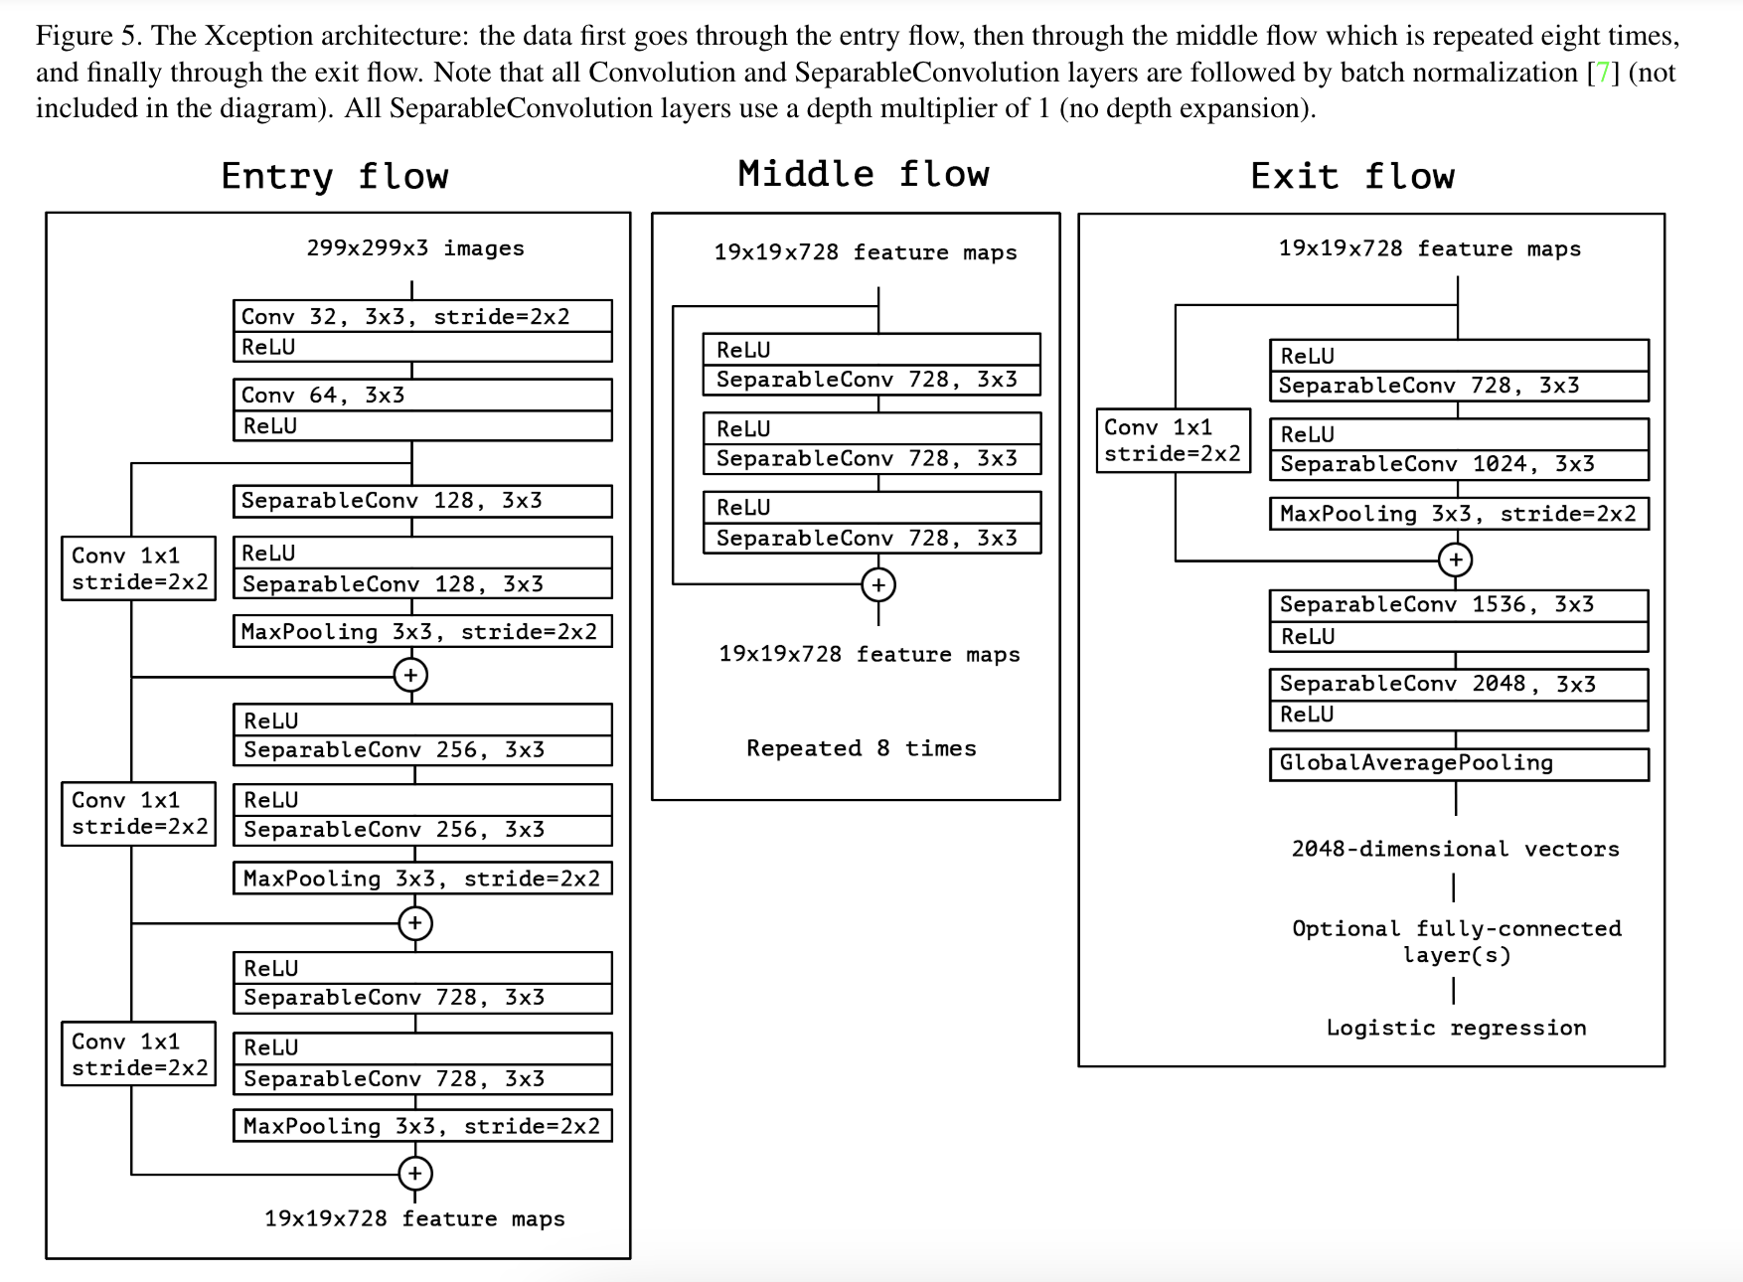
Xception
Xception is built exclusively on depthwise separable convolution layers. At its core, it features a linear stack of these layers with residual connections, making it easy to define and modify.
Despite not being explicitly tailored for deepfake detection, Xception's efficiency and performance make it adaptable to various applications.
Chollet, F. (2017). Xception: Deep learning with depthwise separable convolutions. In Proceedings of the IEEE conference on computer vision and pattern recognition (pp. 1251-1258).

Slide 11
Results of Xception
As mentioned, after the early work of MesoNet and MesoInception, the main metric was cross-dataset generalization and the models trained in FF++ were tested on different datasets.
Network | FF++ Classification Score (AUC) | Celeb-DF Classification Score (AUC)
MesoNet (4) | 0.847 | 0.548
MesoInception (4) | 0.830 | 0.536
Xception | 0.955 | 0.655

Slide 12
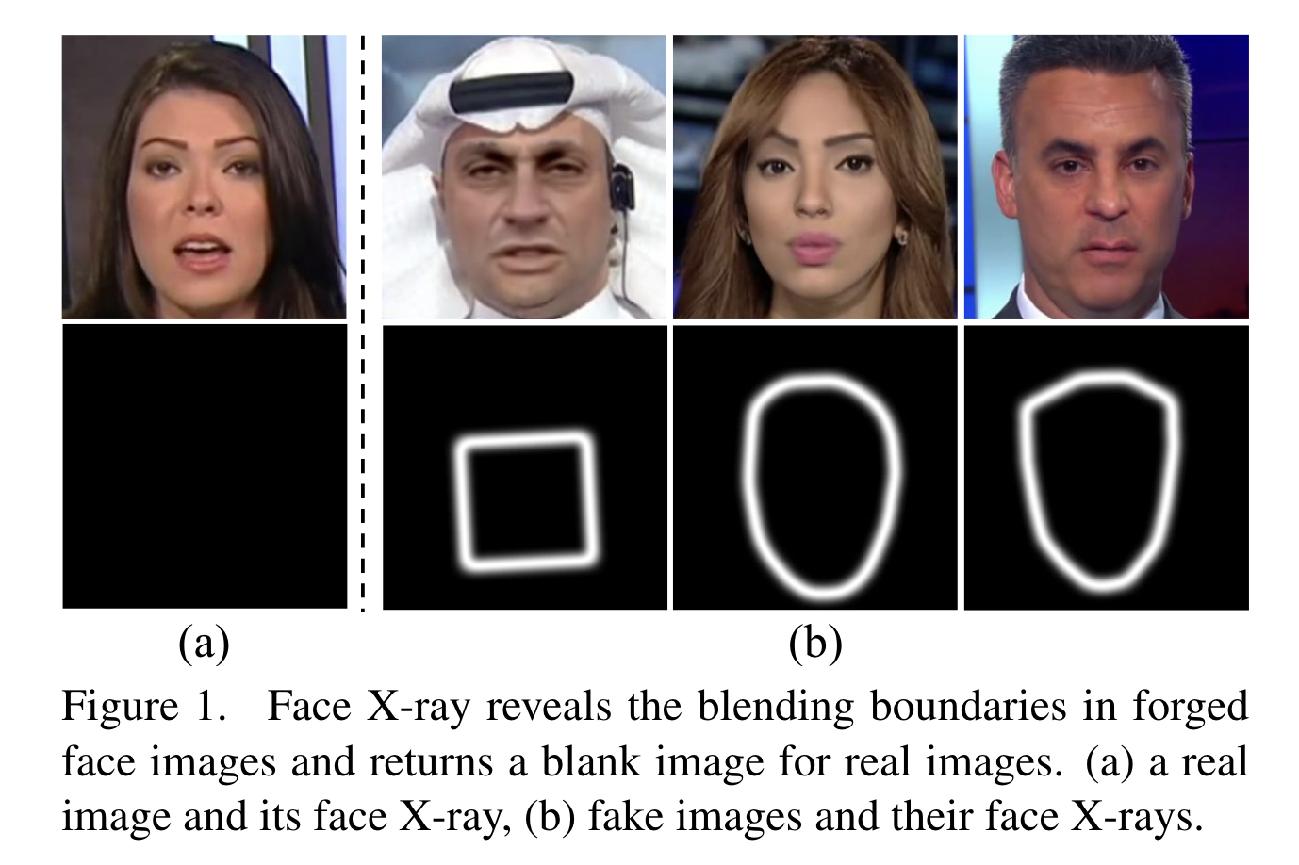
Face X-Ray (CVPR 2020)
Unlike previous methods that require training on examples of specific manipulations, face X-ray only assumes the existence of a blending step. This makes it effective against a wide range of manipulation techniques, even those unseen during training.
Li, L., Bao, J., Zhang, T., Yang, H., Chen, D., Wen, F., & Guo, B. (2020). Face x-ray for more general face forgery detection. In Proceedings of the IEEE/CVF conference on computer vision and pattern recognition (pp. 5001-5010).

Slide 13
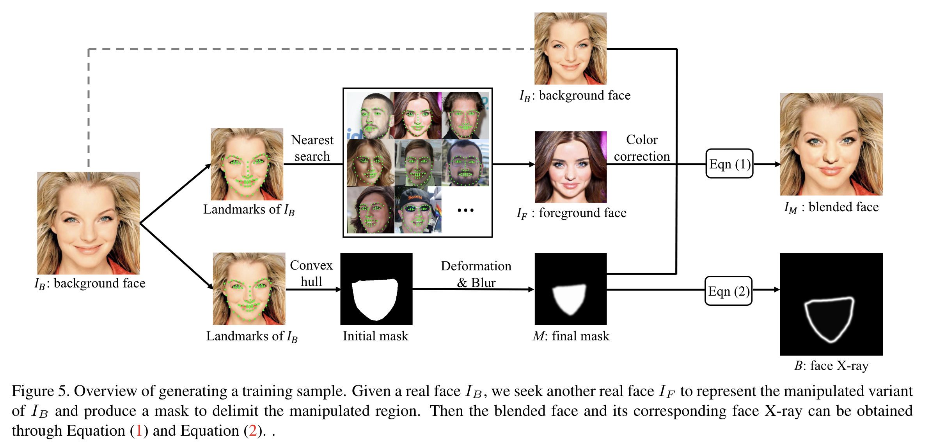
Face X-Ray (CVPR 2020)
The Face X-ray can be trained using only real images by generating synthetic training data by blending real images, eliminating the need for a dataset of manipulated images. This approach significantly improves the generalization ability of the detector.
Li, L., Bao, J., Zhang, T., Yang, H., Chen, D., Wen, F., & Guo, B. (2020). Face x-ray for more general face forgery detection. In Proceedings of the IEEE/CVF conference on computer vision and pattern recognition (pp. 5001-5010).

Slide 14
Results of Face X-Ray
As mentioned, in the training of Face X-Ray, X-Rays of FF++ images are also used, enabling a better generalization. In conclusion, it performed better in different datasets.
Network | FF++ Classification Score (AUC) | Celeb-DF Classification Score (AUC)
Face X-Ray (HRNet Backbone) | 0.9915 | 0.8058
Dong, S., Wang, J., Ji, R., Liang, J., Fan, H., & Ge, Z. (2023). Implicit identity leakage: The stumbling block to improving deepfake detection generalization. In Proceedings of the IEEE/CVF Conference on Computer Vision and Pattern Recognition (pp. 3994-4004).

Slide 15
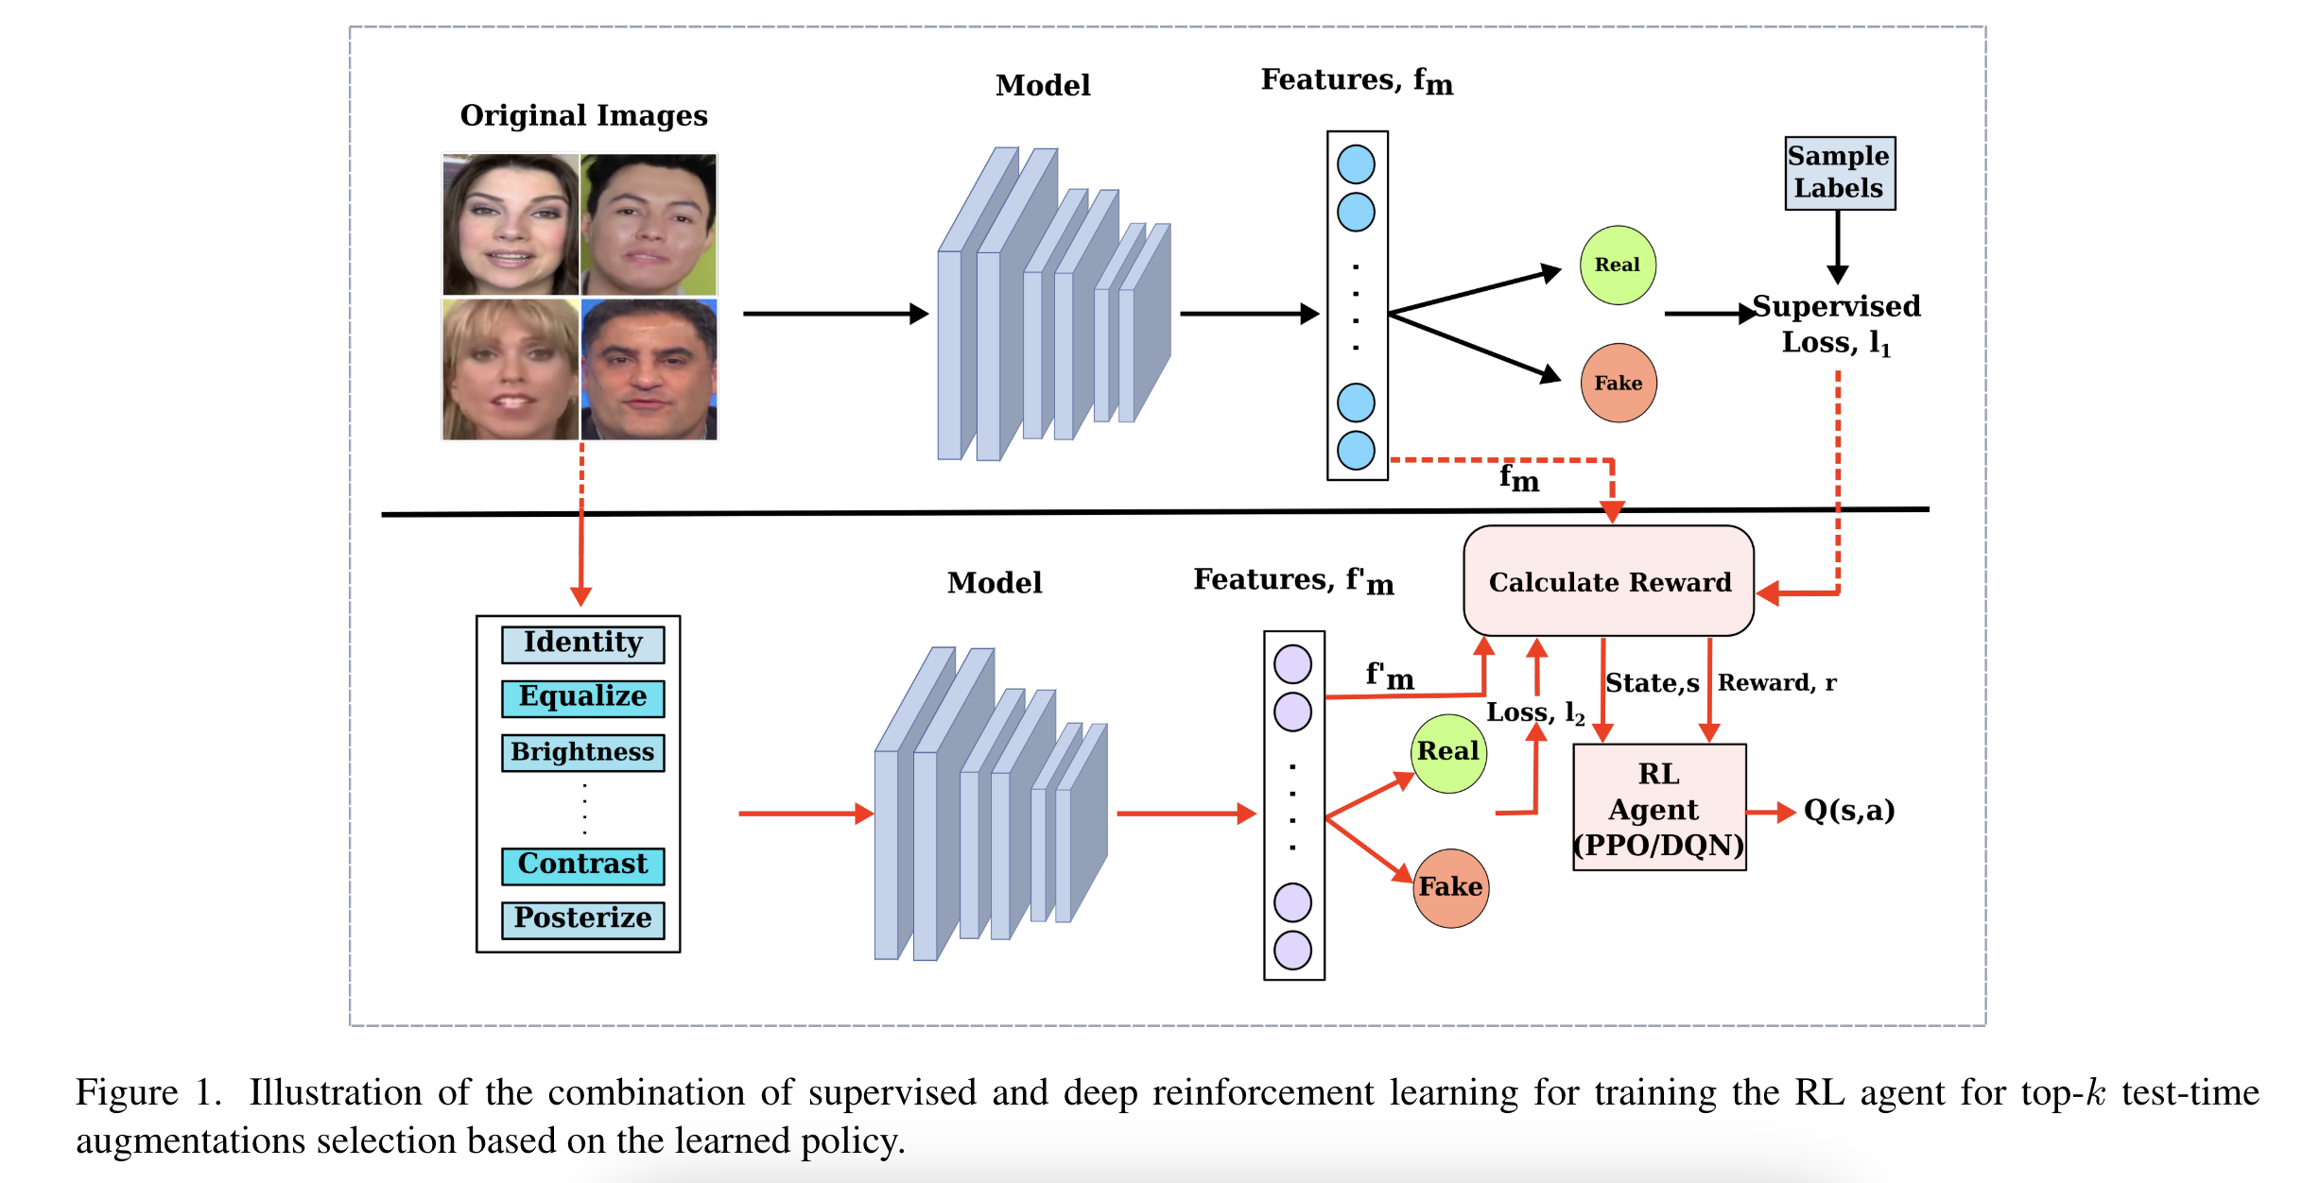
On Improving Cross-dataset Generalization of Deepfake Detectors (CVPR 2022)
The paper introduces a novel method to enhance the cross-dataset generalization of deepfake detectors using a hybrid approach combining supervised learning and reinforcement learning (RL).
An RL agent is trained to select the optimal augmentations for each test image based on a learned policy.
Nadimpalli, A. V., & Rattani, A. (2022). On improving cross-dataset generalization of deepfake detectors. In Proceedings of the IEEE/CVF conference on computer vision and pattern recognition (pp. 91-99).

Slide 16
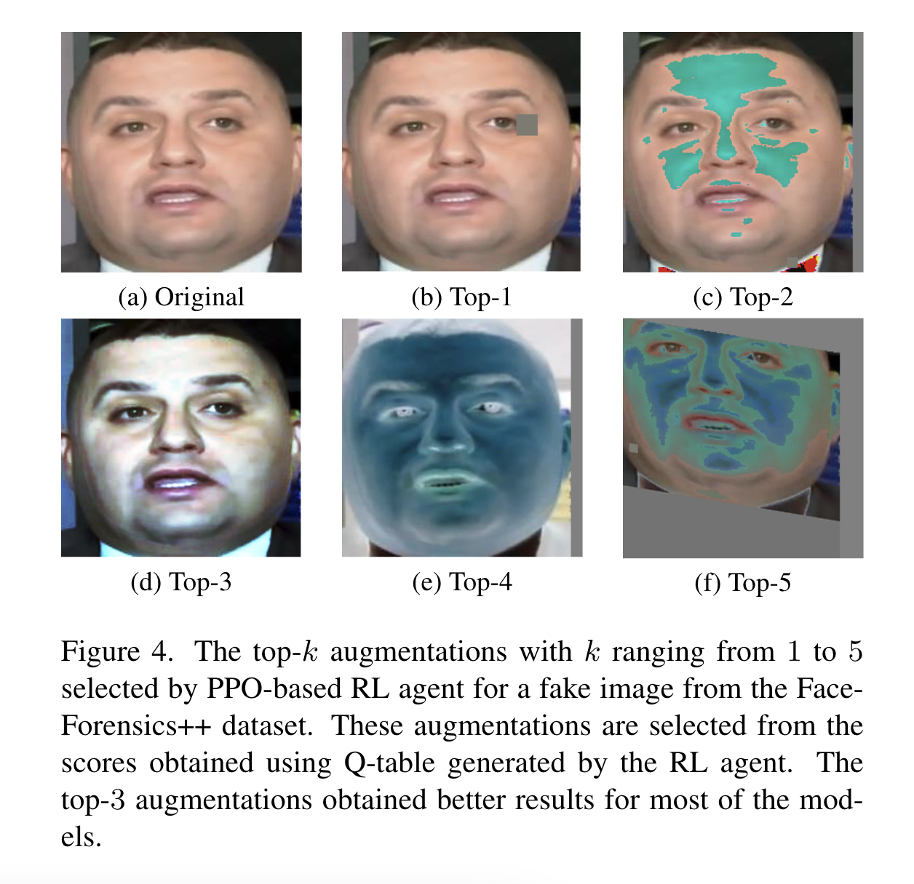
On Improving Cross-dataset Generalization of Deepfake Detectors (CVPR 2022)
The method addresses the common performance degradation issue when deepfake detectors trained on one dataset are tested on another dataset with different characteristics. By systematically selecting augmentations tailored to each test image, the approach reduces the impact of domain shift and improves performance across datasets.
While not having the implementation, it stands out as an approach that brings a new perspective to the problem of cross-dataset generalization.
Nadimpalli, A. V., & Rattani, A. (2022). On improving cross-dataset generalization of deepfake detectors. In Proceedings of the IEEE/CVF conference on computer vision and pattern recognition (pp. 91-99).

Slide 17
Results of “On Improving Cross-dataset Generalization of Deepfake Detectors”
As mentioned, in the training of “On Improving Cross-dataset Generalization of Deepfake Detectors”, reinforcement-learning-guided augmented pictures from FF++ dataset are also used, enabling a better generalization. In conclusion, it performed satisfactory in different datasets.
Network | FF++ Classification Score (AUC) | Celeb-DF Classification Score (AUC)
RL-guided-network (Efficient-v2-L with PPO) | 0.994 | 0.669
Dong, S., Wang, J., Ji, R., Liang, J., Fan, H., & Ge, Z. (2023). Implicit identity leakage: The stumbling block to improving deepfake detection generalization. In Proceedings of the IEEE/CVF Conference on Computer Vision and Pattern Recognition (pp. 3994-4004).

Slide 18
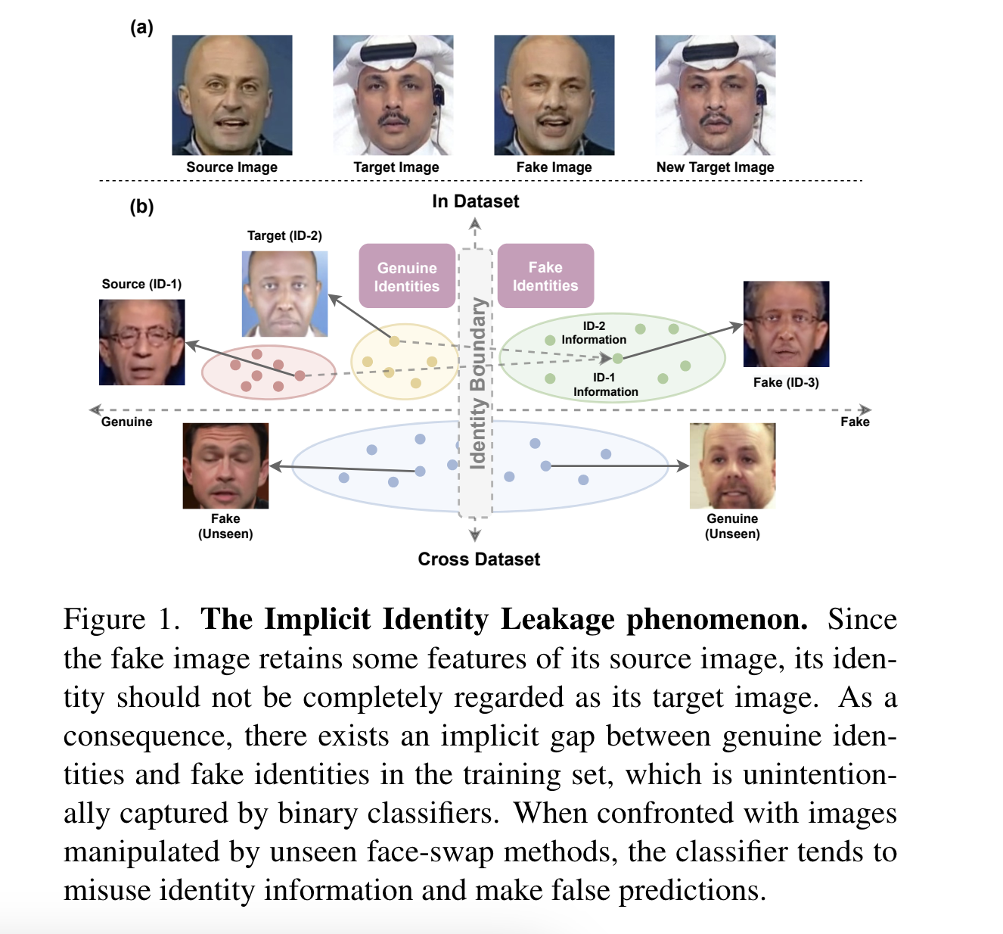
Implicit Identity Leakage (CVPR 2023)
The implicit identity leakage phenomenon: In deepfake detection, the reliance on these global identity features can be problematic because the model might start to recognize an image as genuine, or fake based on the identity-specific characteristics it has learned during training. For example, if a model is frequently exposed to fakes of a particular person during training, it might mistakenly learn that any image of this person is likely to be fake, rather than learning to detect the subtle manipulations indicative of a deepfake.
Dong, S., Wang, J., Ji, R., Liang, J., Fan, H., & Ge, Z. (2023). Implicit identity leakage: The stumbling block to improving deepfake detection generalization. In Proceedings of the IEEE/CVF Conference on Computer Vision and Pattern Recognition (pp. 3994-4004).

Slide 19
Implicit Identity Leakage (CVPR 2023)
Hypothesis 1: The ID representation in the deepfake dataset is accidentally captured by binary classifiers during the training phase when without explicit supervision.
To prove this, they used models trained specifically for deepfake and used them to find the identity and it was successful.
Hypothesis 2: Although the accidentally learned ID representation may enhance the performance on the indataset evaluation, it tends to mislead the model on the cross-dataset evaluation.
They also proved this in the paper.
Dong, S., Wang, J., Ji, R., Liang, J., Fan, H., & Ge, Z. (2023). Implicit identity leakage: The stumbling block to improving deepfake detection generalization. In Proceedings of the IEEE/CVF Conference on Computer Vision and Pattern Recognition (pp. 3994-4004).

Slide 20
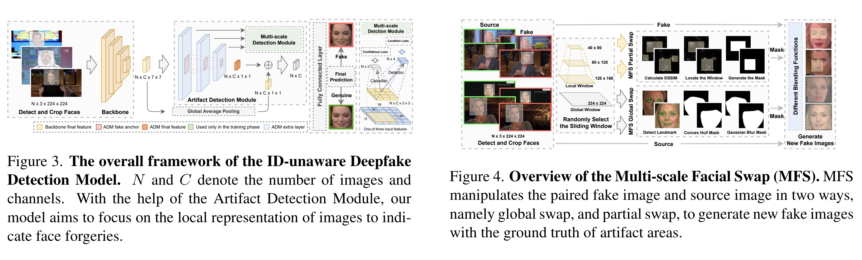
Implicit Identity Leakage (CVPR 2023)
They have two novel approaches:
1- Artifact Detection Module: Instead of concentrating on the whole picture, they aimed to create an architecture that concentrates on specific parts to detect artifacts.
2- Multi-scale Facial Swap (MFS): They created their own dataset with MFS because it is not possible to find public datasets that only swap certain parts of the face (especially with ground truth)
Dong, S., Wang, J., Ji, R., Liang, J., Fan, H., & Ge, Z. (2023). Implicit identity leakage: The stumbling block to improving deepfake detection generalization. In Proceedings of the IEEE/CVF Conference on Computer Vision and Pattern Recognition (pp. 3994-4004).

Slide 21
Results of Implicit Identity Leakage
By discarding the effect of Identity Leakage, using locally manipulated pictures derived from FF++ dataset, and using Artifact Detection Module, the method outstandingly outperformed other models’ generalization capacity.
Network | FF++ Classification Score (AUC) | Celeb-DF Classification Score (AUC)
ID-Unaware Network (Efficient-b4 Backbone) | 0.9979 | 0.9388
Dong, S., Wang, J., Ji, R., Liang, J., Fan, H., & Ge, Z. (2023). Implicit identity leakage: The stumbling block to improving deepfake detection generalization. In Proceedings of the IEEE/CVF Conference on Computer Vision and Pattern Recognition (pp. 3994-4004).

Slide 22
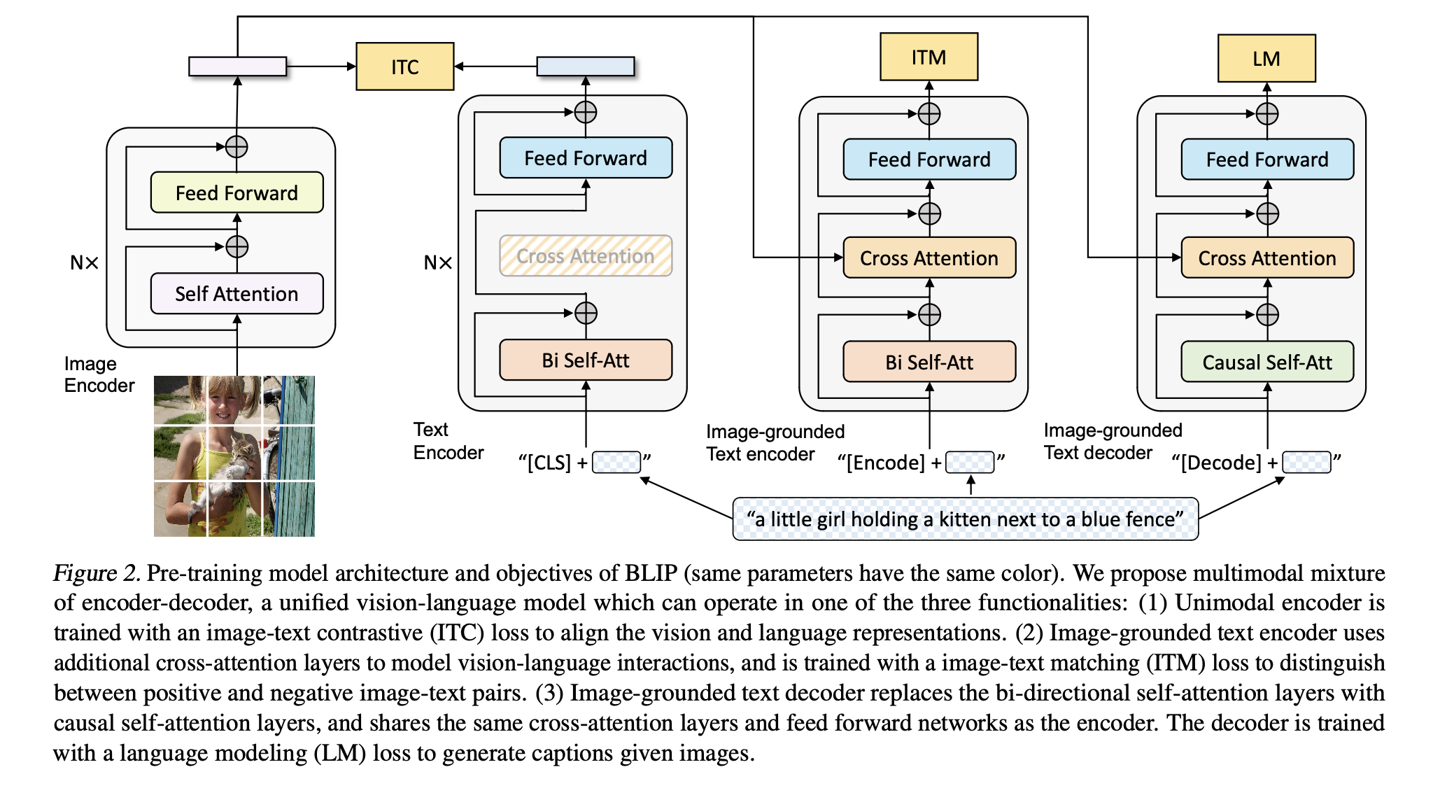
Emirhan’s Method: BLIP
BLIP is a VLP (Vision-Language Pre-training) framework that excels in both vision-language understanding and generation tasks using a multimodal mixture of encoder-decoder model and a novel captioning and filtering method for handling noisy data.
Li, J., Li, D., Xiong, C., & Hoi, S. (2022, June). Blip: Bootstrapping language-image pre-training for unified vision-language understanding and generation. In International conference on machine learning (pp. 12888-12900). PMLR.

Slide 23
Emirhan’s Method: BLIP
In my job, I use BLIP to detect if a room is empty by analyzing images, and it works almost flawlessly.
So, I wanted to test the visual question answering (VQA) version to detect deepfakes by asking, "Is the face in the picture manipulated with deepfake technology?"
I tested the model using 300 random examples from the FF++ dataset. This included 150 Deepfake examples and 150 Real examples, selected from 50 videos. Each video contributed 3 frames to the dataset.
Set | Deepfake Class | Real Class
FF++ | 50 videos (3 frames per video) | 50 videos (3 frames per video)

Slide 24
Emirhan’s Method: BLIP
While the results were far from perfect, with 0.60 accuracy in zero-shot deepfake detection, it is promising given that the model wasn’t trained for this specific task.
Accuracy on DeepFakes | Accuracy on Real Images | Accuracy in Total
0.58 (29 true, 21 false) | 0.62 (31 true, 19 false) | 0.60 (60 true, 40 false)

Slide 25
Comparison of All Mentioned Methods
Network | FF++ Classification Score (AUC) | Celeb-DF Classification Score (AUC)
MesoNet (4) | 0.847 | 0.548
MesoInception (4) | 0.830 | 0.536
Xception | 0.955 | 0.655
Face X-Ray (HRNet Backbone) | 0.9915 | 0.8058
RL-guided-network (Efficient-v2-L with PPO) | 0.994 | 0.669
ID-Unaware Network (Efficient-b4 Backbone) | 0.9979 | 0.9388

Slide 26
Implementations
All papers except “On Improving Cross-dataset Generalization of Deepfake Detectors” have implementations and I tested them. The codes of the papers can be accessed via the following link:
https://colab.research.google.com/drive/1mCynH1FuPHOCbfhhk0Iw9NGq20clmXu2?usp=sharing
Emirhan’s Method’s code, all the training logs, and the dataset used can be found in this GitHub repo I created:
https://github.com/emirhanbilgic/Emirhans_Method_Deepfake

Slide 27
Paper Results vs. Implementation Results
To download FF+ dataset, the steps in the following link should be followed: https://github.com/ondyari/FaceForensics
To test the methods with cross dataset, i.e. Celeb-DF, the dataset should be downloaded by following the steps in the link: https://github.com/yuezunli/celeb-deepfakeforensics.
Of the methods mentioned throughout the slide, the official implementations of MesoNet, MesoInception, and ID-Unaware Network are tested thoroughly. The results with the already trained weights are the same as claimed in the paper, while the results of the models trained from scratch show slight differences.
 | Paper Results |  | Implementation Results
Network | FF++ Classification Score (AUC) | Celeb-DF Classification Score (AUC) | FF++ Classification Score (AUC) | Celeb-DF Classification Score (AUC)
MesoNet (4) | 0.847 | 0.548 | 0.822 | 0.519
MesoInception (4) | 0.830 | 0.536 | 0.820 | 0.510
ID-Unaware Network (Efficient-b4) | 0.9979 | 0.9388 | 0.988 | 0.897

Slide 28
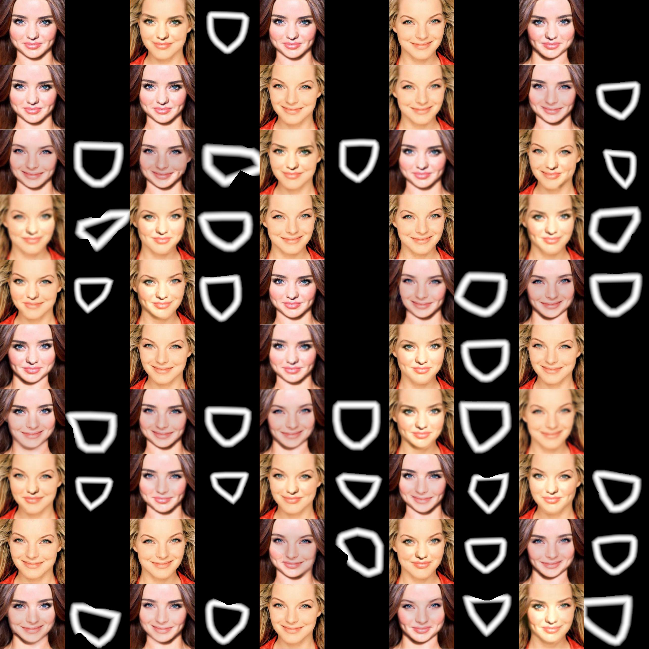
Implementation Result of Face X-Ray
The Face X-Ray method was also tested with its unofficial implementation in the X-ray generation section. The results can be seen on the right-hand-side:

Slide 29
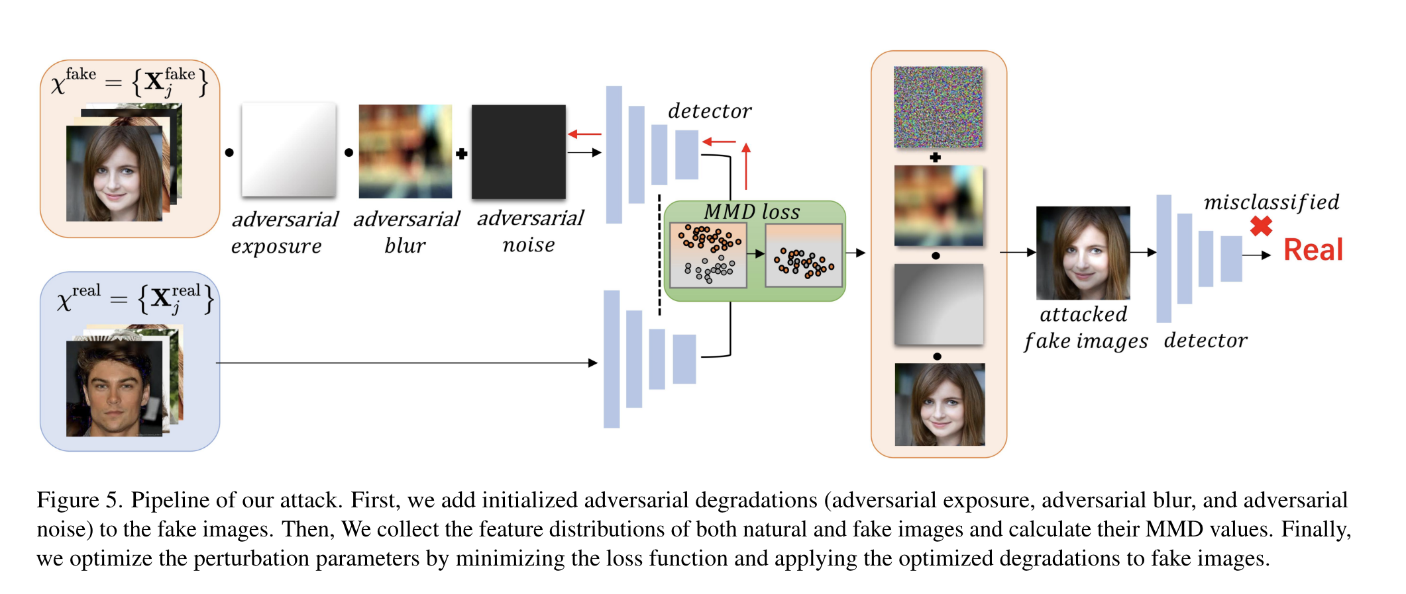
Future Work
Evading DeepFake Detectors via Adversarial Statistical Consistency
(CVPR 2023)
The robustness of deepfake detectors against adversarial attacks should also be investigated. For example, the StatAttack method, which minimizes statistical differences between real and fake images, can effectively evade many existing detection systems.
Some modifications to the generated deepfake image (adding noise, etc.) can significantly reduce the accuracy of the models.
Hou, Y., Guo, Q., Huang, Y., Xie, X., Ma, L., & Zhao, J. (2023). Evading deepfake detectors via adversarial statistical consistency. In Proceedings of the IEEE/CVF Conference on Computer Vision and Pattern Recognition (pp. 12271-12280).

Slide 30
Conclusion
In this study, we compare various methods, including those that emphasize lip movements and temporality. Although deepfake detection methods are being improved, deepfake generation methods are being improved even faster due to the popularity of generative AI.
Furthermore, as discussed, various methods are emerging to mislead deepfake detectors. For this reason, it is very important to accelerate the work in this field.
For more:
https://github.com/Daisy-Zhang/Awesome-Deepfakes

